Slide 1
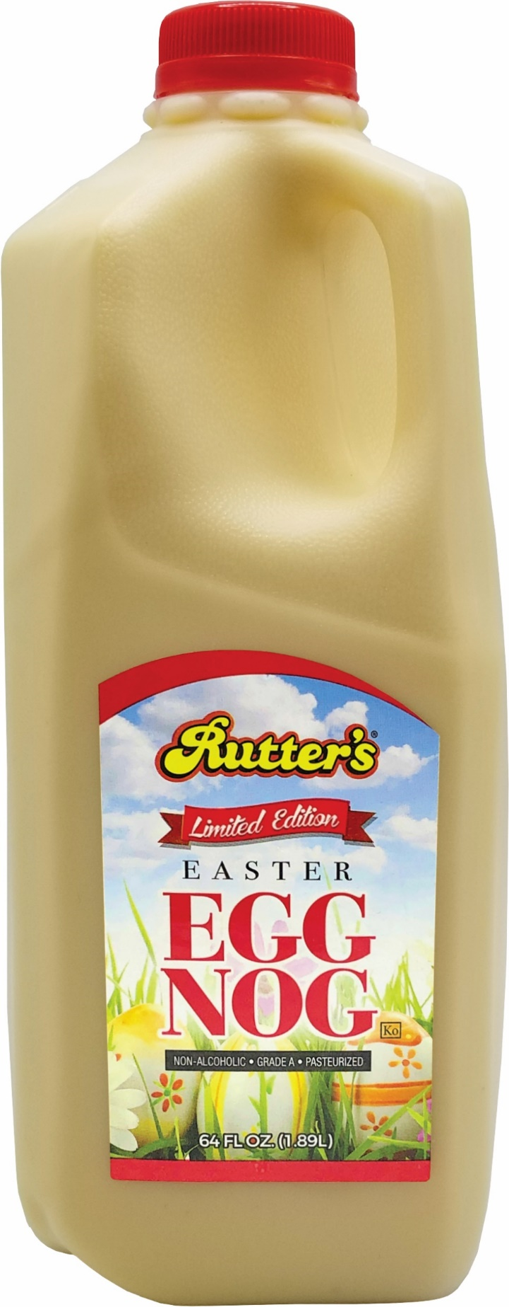

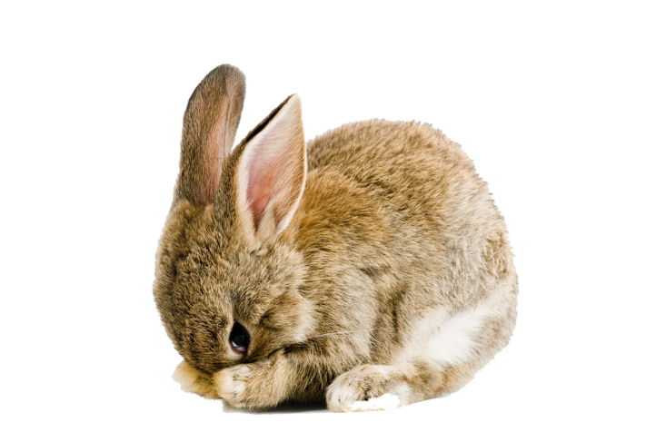




EASTER
Limited Edition
EGG
NOG
Available
March 7th
Product Code: 250
Size: ½ Gallon
Unit per case: 9
UPC# 71156 50124
Contact your
Sales Representative
for more information.

Slide 2


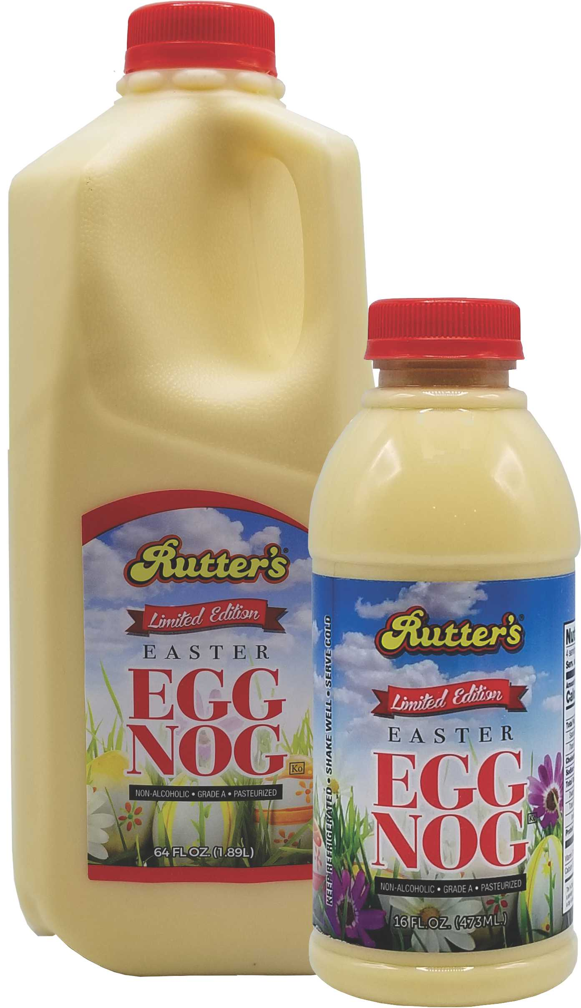
Limited Edition
EASTER
Available
March 7th
EGG
NOG
Product Code: 250
Size: ½ Gallon
Unit per case: 9
UPC# 71156 50124
Product Code: 252
Size: Pint
Unit per case: 16
UPC# 71156 12703
Contact your
Account Manager
for more information.
Full case purchase not necessary.

